Slide 1
BLACK FRIDAY SALES
KSHITIJ SANKESARA
YUNXI DONG
VIJET MULEY

Slide 2
Problem and goal
A retail company wants to understand the customers spending behavior
We use the past sales data set to understand and predict the purchase amount of customers
We built and compared models based on the accuracy to predict the amount.
This will help create personalized offers for the customers against different products

Slide 3

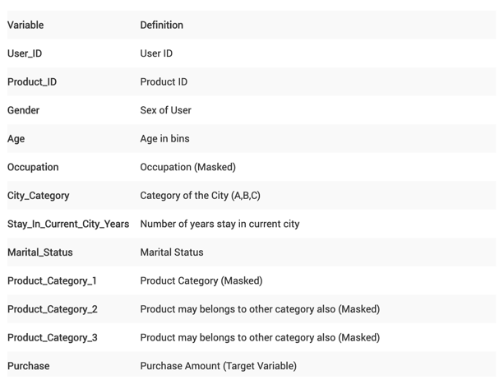
DATA
538k Rows and 12 columns

Slide 4
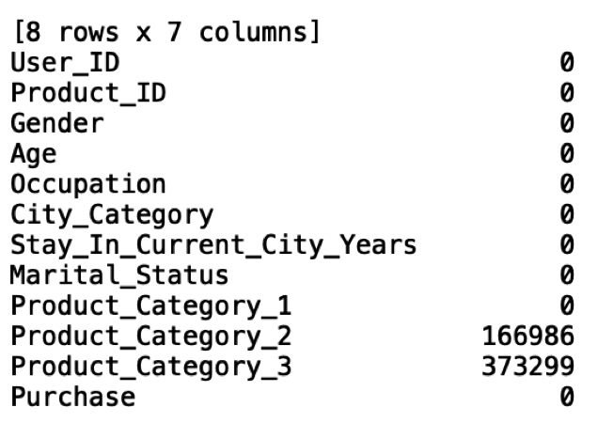
Data Cleaning
Removed User_ID and Product_ID
Missing Values – Filled all the missing values with 0

Slide 5
Descriptive analysis

Slide 6
Descriptive statistics
Occupation of people and their purchase count
Most number of purchase count by occupation 0, 1, 4, 7, 17 and 20.

Slide 7
Descriptive statistics
Age Group of people and their count of purchase
Age groups between 18-45 are the ones who purchases the most.

Slide 8
Descriptive statistics
Product and City Category with respect to Purchase Amount

Slide 9
Descriptive statistics
Product Category 1 and its Frequency
Product Category 1, 5 and 8 were purchased the most.

Slide 10
Product category
We used dummies for the top 3 category (1,5 and 8)
Dummy_1= 1, if Product_Category_1==1 or Product_Category_2==1 or Product_Category_3==1
Dummy_5=1, if Product_Category_1==5 or Product_Category_2==5 or Product_Category_3==5
Dummy_8=1, if Product_Category_1==8 or Product_Category_2==8 or Product_Category_3==8

Slide 11
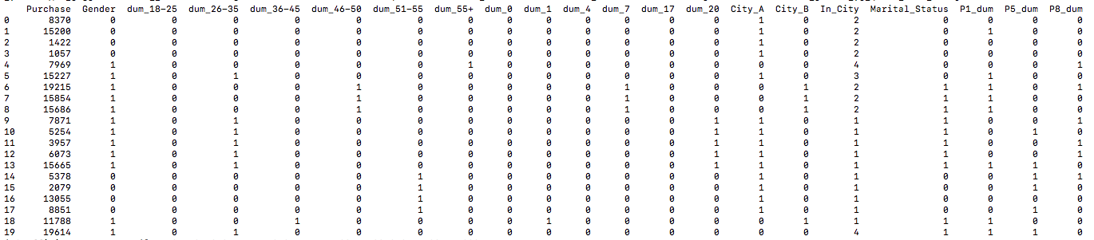
LINEAR REGRESSION
The new data frame with the dummy variables

Slide 12
Linear regression – Dummy variables
For ‘Gender’: ‘F’ is taken as baseline, i.e. 0 and ‘M’ as 1.
For ‘Age’: We have 7 bins originally, so we made 6 dummy variables and 0-17 bin is baseline (all dummies 0)
For ‘Occupation’, we selected 6 categories out of 20 that had highest number of observations, those are 0,1,4,7,17,20. All the other categories are baseline.
For ‘City Category’, 2 dummy variables for category A and B, C is the baseline.
Stay in current city, marital status and dummies for product categories 1,5 and 8 are taken as it is.

Slide 13
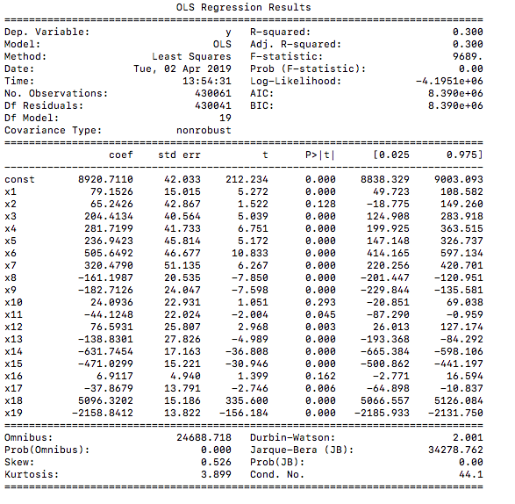
Linear regression Output

Slide 14
Linear regression output
3 explanatory variables have a p-value higher than 0.05, thus they are less significant.
R-squared and adjusted R-squared, both, are 0.3
Regression shows that :
Males tend to spend more than females
Every additional year in the city leads to a decrease in the amount of purchase
Spending pattern is not related to age.

Slide 15
Random forest
Both regressor (for numerical) and classifier (for binned values).
For regressor, the leaves will have mean of the purchase values of all the data points it has.
For classifier, we will be making bins of certain width. The bins would accommodate values in a specific range.

Slide 16
Changes
The categorical fields had bins that are strings (like ‘F’, ‘18-25’ etc.)
We used LabelEncoder to encode these categories.
we use StandardScaler to scale the data.
This is done because different attributes can have different range of values.

Slide 17
Random Forest Regressor:
We split original data into explanatory and target variable data frames.
Then we split both the data frames into training and testing sets. The ratio is 80% training and 20% testing.
Multiple implementations with 700, 800, 1200, 2000, 3000, 4000 maximum number of leaf nodes.

Slide 18
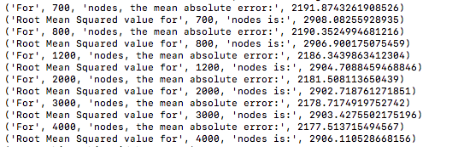
Error terms for regressor:

Slide 19
Random Forest Classifier:
We split the ‘Purchase’ column to 5 bins.
Highest accuracy of 62.18% for a forest with 150 trees and maximum 1500 leaf nodes with Information Gain criteria.
61.98% accuracy for Gini Index with a forest of 150 trees and each tree having maximum 1250 leaf nodes.

Slide 20
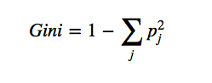
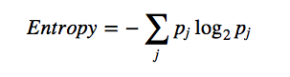
Gini vs Entropy:
These are measures of impurities.
Entropy is 0 if all the nodes belong to same category, and is highest if they are evenly distributed over different categories.
Same goes for Gini Index, it is 0 if all the nodes belong to same class and is highest if the nodes are evenly distributed over different categories.
Gini is the faster one, because complicated logarithmic calculation is avoided.
Both give, more or less, the same results.

Slide 21
Naïve Bayes model:
Gaussian Naïve Bayes model is used.
The Naïve Bayes model did not need any different kind of pre-processing and munging of data than Random Forest Classifier.
Highest accuracy achieved: 63.23%
This accuracy was achieved when the target variable was binned into 3 bins.

Slide 22
Summary on the basis of accuracy:
Linear Regression:
Adjusted R-Squared: 0.300
16 out of 19 parameters are significant.
Random Forest Regressor:
Smallest Root Mean Squared Error : 2902.718761271851
Maximum number of leaf nodes pertaining to this error: 2000
Random Forest Classifier:
Highest Accuracy: 62.18%
Setting: Number of trees in the forest: 150, maximum leaf nodes: 1500, Gain (entropy) criteria.
Naïve Bayes:
Highest Accuracy: 63.23%
Target variable binned into 3 categories

Slide 23
Comparison on the basis of time:
Linear regression:
Total execution: 5.888156890869141 seconds
Random Forest Regressor:
Pre-processing: 1.8084118366241455 seconds
Execution: 11.367883920669556 seconds
Random Forest Regressor:
Pre-processing: 1.984044075012207 seconds
Execution:90.13988089561462 seconds
Naïve Bayes:
Pre-processing: 5.1625471115112305 seconds
Execution: 5.461106061935425 seconds

Slide 24
Best model?
However, the result is not as satisfactory as Random Forest Classifier.
The highest accuracy was achieved when the target variable was binned into 3 bins.
When the number of bins was increased to 4, the accuracy dropped down drastically to 48.46%
Possible reason is that as the number of bins increase, the data on the increasing number of borders is increasing.
Thus, the model is not correctly classifying that data correctly.
The reason behind saying that Naïve Bayes isn’t as good as Random Forest Classifier in our case, is the drastic drop in accuracy.
With Random Forest Classifier, the drop was there, but it wasn’t this drastic.

Slide 25
Conclusion:
For the Black Friday sales data, Random Forest Classifier proved to be the best model, on the basis of accuracy.
However, it is also the model that took relatively the most amount of time to be executed.
Despite that, we’d conclude that Random Forest Classifier is the best possible solution of all the implemented solutions.

Slide 26
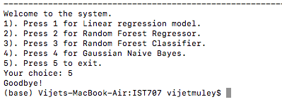
Summary of the project
Menu driven system, terminal based.

Slide 27
Flexibility:

Slide 28
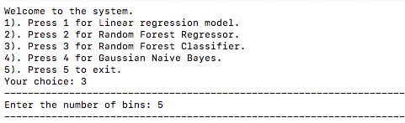
Random Forest Regressor:

Slide 29
Issues faced:
New to machine learning concepts:
Took time to understand before implementing.
May be a reason why we couldn’t implement more models.
Data integrity:
Almost every model needed data to be munged differently.
Ran into a lot of errors due to data not being in proper format as required by the models.
Maximum amount of time and efforts were spent on data cleaning and re-formatting.
Another issue that was faced was overfitting.

Slide 30
What we intended to do:
Clean and re-format the Black Friday sales data.
Analyze the data.
Implement machine learning in an attempt to predict the amount spent by a customer based on the customer’s details.
Compare the models implemented on the basis of accuracy and time taken.
Add a functionality in the system so that the models can make a prediction for a previously unknown customer based on the details entered by the user.

Slide 31
What we managed to complete:
Clean and re-format Black Friday sales data.
Ran statistical and visual analysis.
Succeeded in implementing 4 predictive models to learn patterns from the data and help in forecasting sales amount.
Compared the models based on the accuracy and time taken.
What we could not complete:
Add the functionality to make a prediction for an unknown customer.

Slide 32
Thank you

